Slide 1
PUNJAB URBAN LAND SYSTEMS ENHANCEMENT PROJECT (PULSE)
STANDARD OPERATING PROCEDURES
ENVIRONMENTAL AND SOCIAL SAFEGUARDS

Slide 2
ENVIRONMENTAL AND SOCIAL COMMITMENTS OF PULSE PROJECT
PULSE Project under Board of Revenue and Punjab Land Records Authority committed to Environmental and Social Safeguards
To identify opportunities & risks enabling
To establish systems and resources
To effectively deal with all E&S issues associated within land administration.
The Project has developed multiple Framework documents as a mitigation measure :
Preparation and Implementation of Standard Operating Procedures (SOPs) for Survey and Parcel Mapping Activities of the project.
Communication Strategy
Gender Action Plan
E-Waste Management Plan
Labour Management Plan
Resettlement Policy Framework
Stakeholder Engagement Plan

Slide 3
PURPOSE OF ENVIRONMENTAL AND & SOCIAL SOPs
1
Social and Environment Risk Assessment & Mitigation Measures
2
Stakeholder/ Community Engagement
3
Safeguarding Vulnerable Groups
4
Accountability Transparency
5
Environmental and Social Performance Monitoring
6
Compliance with World Bank Guidelines

Slide 4
STAKEHOLDER/COMMUNITY ENGAGEMENT DURING FIELD ACTIVITIES
Identification of Key Stakeholders in Respective Districts | Planning of provincial and district specific stakeholder’s engagement activities | Execution of Stakeholder Engagement Activities | Address Stakeholder Concerns with relevant Authorities | Modifications in on-going communication activities | Modification in Stakeholder Engagement Plans | Regular reporting of the Stakeholder Engagement activities

Slide 5
STANDARD OPERATING PROCEDURES (SOPS) DURING FIELD ACTIVITIES
Prior to the start of survey activity in a district, Project orientation meeting
Necessary approvals from the relevant departments/authorities to initiate survey activities
District specific Social Mapping and Community engagement planning
Strict compliance of Environment, Health, Safety Specifications (ESHS), GBV/SH
E&S section will facilitate survey firms staff training session on E Waste Management.
Contd.

Slide 6
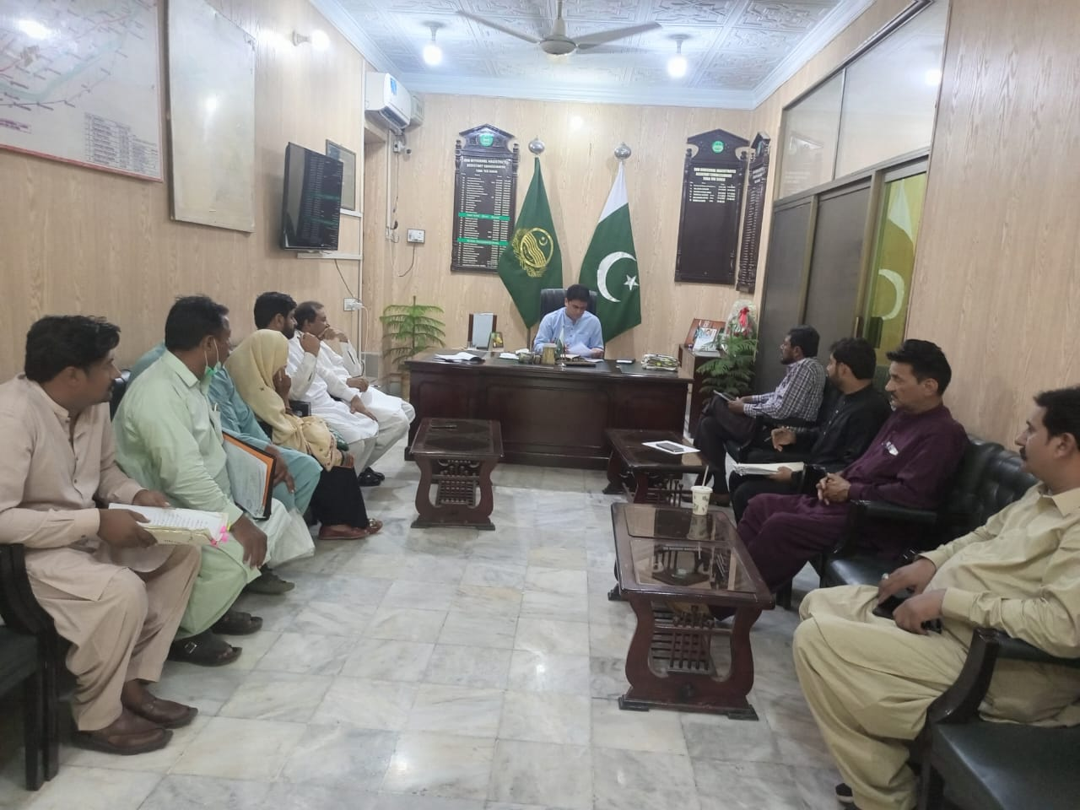
STAKEHOLDER ENGAGEMENT AT DISTRICT LEVEL

Slide 7
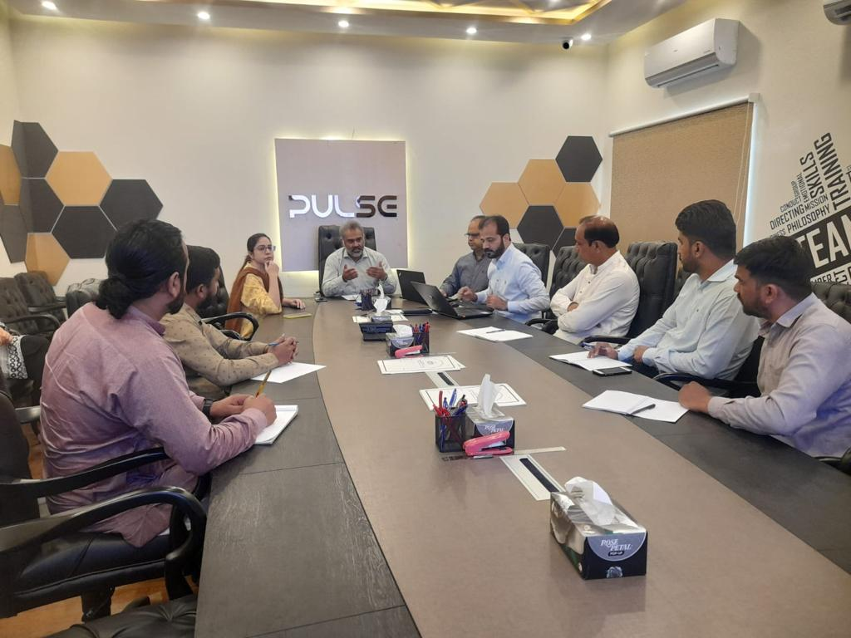
CAPACITY BUILDING

Slide 8
STANDARD OPERATING PROCEDURES (SOPS) DURING FIELD ACTIVITIES
Orientation session of the parcel mapping survey teams on E&S Commitments up to the level agreed for WB
Detailed training of the Community Workers/Surveyors/Community Engagement Associates a (to be placed at district level) on E&S Safeguards and monitoring of the contractors activities and reporting
Stakeholder Engagement Workshops at district (public sector, private sector, non-governmental organizations, civil society organizations, local communities, vulnerable groups)
Contd.

Slide 9
STANDARD OPERATING PROCEDURES (SOPS) DURING FIELD ACTIVITIES
Frequent consultations/focus group discussions, community meetings, workshops at local community level to ensure the participation of all relevant stakeholders, providing information and opportunities for input, and addressing concerns and fears.
Communication plan that includes the channels, frequency, and content of communication with the stakeholders.
The survey firms will establish in house robust monitoring and reporting system to track the implementation of environmental and social safeguards till the completion of their deliverable.
The project will establish in house robust monitoring and reporting system to track the implementation of environmental and social safeguards.
Contd.

Slide 10
PULSE PROJECT’s COMMITMENT TO GENDER MAINSTREAMING

Slide 11
PULSE GENDER STRATEGY
PULSE project considers Gender as a cross cutting aspect of the project
A Gender Strategy prepared to ensure that gender sensitive approach is incorporated in project design and SOPs
GBV RISK ASSESSMENT &
Gender Action Plan
To identify potential risk factors of GBV and SEA/SH
Literature Review of existing policies, legal reforms, Measures taken by GoPb
Public Awareness/ Women’s Land Rights Advocacy
Targeted awareness campaigns:
Highlight Legal reforms on Women Property rights/ GBV/SH
Social and cultural barriers
Access to information and resources
Proposed Methodology
Outcome
Preparation of Gender Action Plan to mitigate GBV/SH Risks
Data Collection through Focused Group Discussions FGDs, Surveys, Stakeholder and Community Consultations
Contd.

Slide 12
PULSE GENDER STRATEGY
Stakeholder and Community Engagement
Stakeholder Engagement with Academia, NGOs, Government Departments, district administrations to update/revise existing frameworks and plans
Capacity Building on Women’s Rights and GBV Risks
Implementers/Project Staff
Government officials
Field and operational level (surveyors, registration staff)
Project beneficiaries
Contractors
Gender Sensitive Dispute Resolution
Operationalization of a grievance redress mechanism (GRM) to address a range of grievances, including property rights issues & GBV sexual harassment
Engagement with community leaders, Opinion leaders, grass root level NGOs and CBO community to dispel misconceptions/misinformation regarding the project
Building the narrative that women are also key beneficiaries of the project

Slide 13
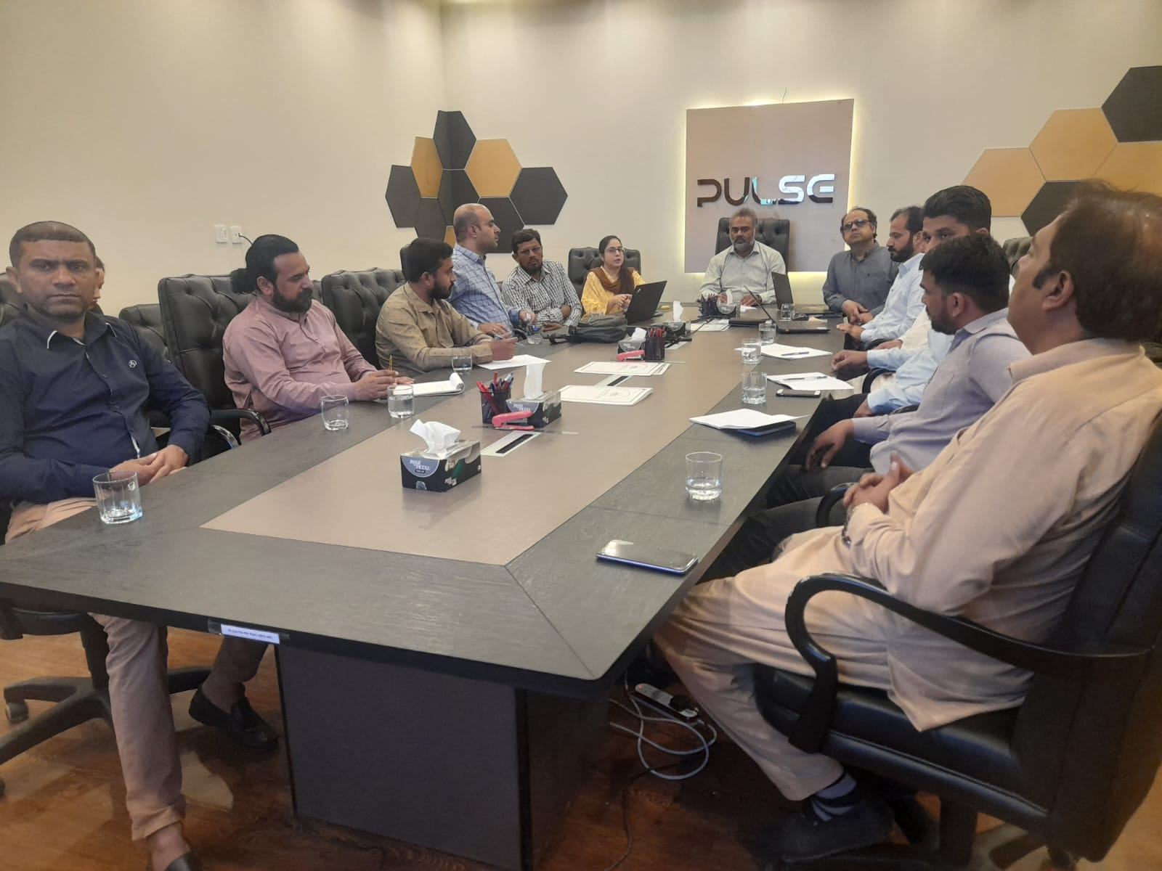
PULSE INITIATIVES ON GBV/SH AND CAPACITY BUILDING

Slide 14
SOPs for GENDER CONSIDERATIONS DURING SURVEY & PARCEL MAPPING ACTIVITIES
Preparation and distribution of printed Guidelines for Contractors/Field teams: GBV/SEA/SH Risks Inclusion, Non discrimination Privacy Concerns
Capacity building of Contractors/ field staff before and during the survey and mapping activities initially in Hafizabad and Lodhran: Gender based violence/Sexual harassment/Reporting Mechanism Sensitization on needs of vulnerable groups such as minorities Formal Consent Good behavior in Community
Stakeholder/Community engagement with: Opinion leaders District Administration Opinion leaders/Community Leaders Local NGOs CBOs
Implementation of Gender Action Plan

Slide 15
GRIEVANCE REDRESS MECHANISM

Slide 16
GRIEVANCE REDRESS MECHANISM
1
GRM Mapping under PULSE project scope and proposed actions
2
Preparation of standard operating procedures for GR system
3
Preparation of GRM Manual/Action Plan
4
Notification of GRM Committee along with ToRs
5
Development of GR-MIS and synchronizing with PLRA GR system
6
Notification & Training of GRM Focal Persons
7
GR System to be in placed and recording of complaints at Arazi Record Centers
Contd.

Slide 17
GRIEVANCE REDRESS MECHANISM
8
Public awareness Activities
9
10
Closure of the complaints, communicated the resolution to the complainer and getting feedback from the affectees
11
12
Investigation and resolution of grievances
Assessment of efficiency of GM on yearly basis through third party
Continuous improvements in the GRM System during the project Cycle

Slide 18
THANK YOU !
1

